Slide 1
Course: Software Project Lab (SPL-01)
Presented by: Prottoy Paul
Roll: 1613
Date: 13-09-2025
Supervisor:
Shah Mostafa Khaled

Slide 2
Mastering Optimization:
The Branch & Bound Algorithm
Project Title:
Branch and Bound Solver for Knapsack and TSP

Slide 3
Project Overview:
Tackling NP-Hard Problems
Our objective is to design and implement the Branch and Bound algorithm for two classic NP-hard optimization problems:
0/1 Knapsack Problem:
Maximizing value within
a capacity constraint.
Travelling Salesman Problem (TSP):
Finding the shortest route visiting
all cities once.
These problems represent crucial real-world scenarios where optimal decision-making under constraints is paramount.

Slide 4
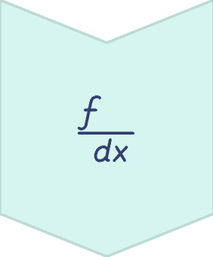

The Power of Pruning:
Branch and Bound vs. Brute Force
The core of this project is to demonstrate how Branch and Bound dramatically reduces computational effort compared to brute-force approaches. Intelligent pruning allows us to achieve optimal solutions more efficiently.
Brute Force
Exhaustive search of all possible solutions.
Branch & Bound
Systematic search with intelligent pruning.

Slide 5
State-Space Tree: Visualizing the Search
For each problem, a state-space tree will be developed. This tree visually represents the exploration of possible
solutions, where each node corresponds to a partial or complete solution.
Nodes
Represent partial or complete solutions.
Branches
Represent choices made during the solution process.
Bounding Functions
Represent choices made during the solution process.
Estimate best possible outcomes to guide pruning.

Slide 6
Bounding Functions:
Guiding the Search
Bounding functions are crucial for the Branch and Bound algorithm. They estimate the best possible outcome from a given node, helping to decide whether to explore or prune certain branches.
0/1 Knapsack Problem
Travelling Salesman Problem
Upper Bound Function: Estimates the maximum possible profit achievable from a given state, guiding us to potential optimal solutions.
Lower Bound Function: Estimates the minimum possible cost to complete a tour from the current partial path, preventing exploration of unpromising routes.

Slide 7
Measuring Algorithm Effectiveness
The success of our Branch and Bound implementations will be rigorously measured and compared against brute-force methods.
Nodes
Time
Quality
Generated & Explored
Execution Time
Solution Quality
Direct measure of computational effort.
Performance benchmark for efficiency.
Ensuring optimality is maintained.

Slide 8
Implementation Focus: Design & Optimization
Our project emphasizes strong software engineering principles, focusing on robust data structures, efficient memory management, and overall algorithmic optimization.
Algorithmic Optimization
Data Structure Design
Efficient Memory Management
Creating optimal structures for nodes and state representation.
Minimizing memory footprint, especially for large problem instances.
Refining the algorithm for peak performance and scalability.

Slide 9
Conclusion: The Value of Branch and Bound
The project culminates in a comprehensive comparative analysis, highlighting the significant performance
improvements gained by Branch and Bound over brute-force methods, all while maintaining solution optimality.
Completed work will include:
Well-documented source code.
Performance tables and charts.
A comprehensive report covering design, implementation, testing, and efficiency evaluation.

Slide 10
THANK YOU

